Slide 1
COVID19 and airline Travel
An analysis of United States COVID case number trends
compared with numbers of airline travelers.

Slide 2

Project Summary
This project set out to explore COVID19 case data compared to airline traveler data in the United States.

Slide 3
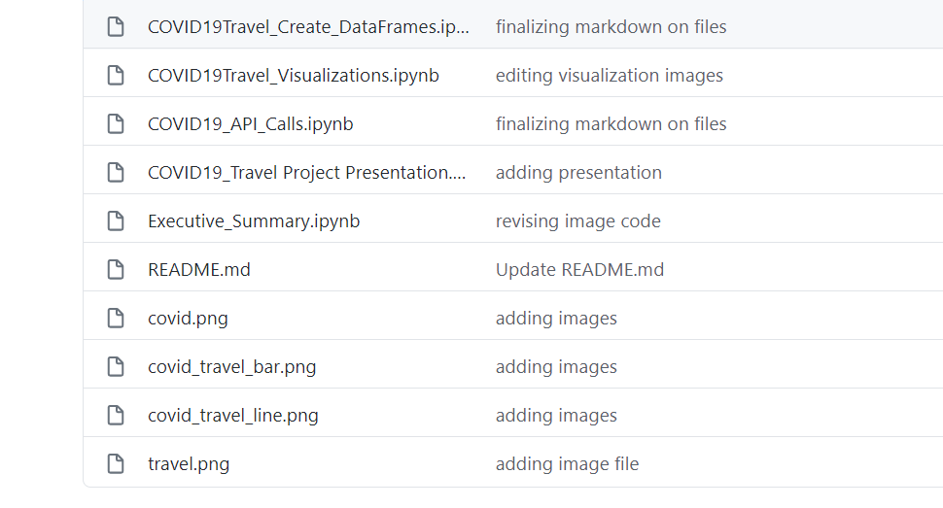
GitHub Repository
https://github.com/abielhammonds/COVID19_TravelStats_Project

Slide 4
Step 1: Start working through the code needed to collect the data (API), organize the data (DataFrames), and visualize the data
Project process
Step 2: Adapt for the challenges along the way (API call vs. download huge dataset) and the length of the code (create multiple notebooks organized around major steps)

Slide 5
Step 3: Once working code is developed, write an overview of what each notebook accomplishes and cleanup any comments so that they make sense (I changed a lot of code along the way, what was I left with?)
Project process
Step 4: Create an Executive summary to highlight the observations and visualizations (I felt the Visualizations notebook was too long and emphasized process vs. product)

Slide 6
Project questions
What was 'typical' travel like each month in 2019 and 2020?
What were the COVID trends in 2020 for those same date ranges?
What was the correlation between COVID and travel in the early (March/April), middle (May -July), and late( (Aug - Oct) parts of the 'first wave' of COVID 2020?
Note: the longer term plan is to continue to follow the trend through the end of 2020 and into 2021 as the COVID second wave plays out this Fall/Winter.

Slide 7
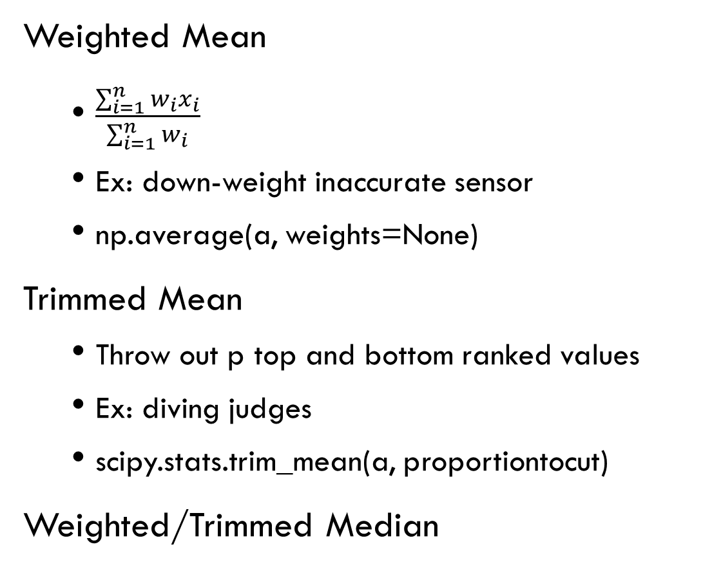
Other Measures of Center
Weighted Mean
$\frac{\sum_{i=1}^{n}{w_{i}x_{i}}}{\sum_{i=1}^{n}{w_{i}}}$
Ex: down-weight inaccurate sensor
np.average(a, weights=None)
Trimmed Mean
Throw out p top and bottom ranked values
Ex: diving judges
scipy.stats.trim_mean(a, proportiontocut)
Weighted/Trimmed Median

Slide 8
Percentile Ranks/Quartiles
Percentile Rank and Quartiles
Percentile rank - The nth percentile is the smallest number that is greater than or equal to a certain percentage of the data points
E.g. – If you score in the 75th percentile on an exam, you scored better than 75% of people taking the same test
Quartiles – special case of percentiles – divide the data into 25%, 50%, 75% percentiles

Slide 9
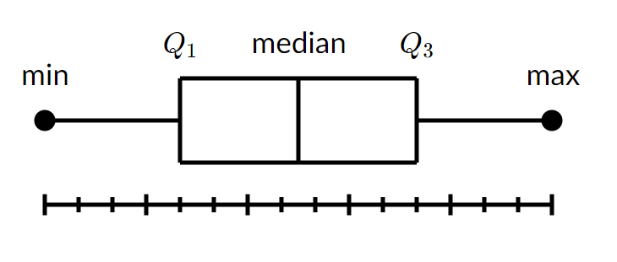
Box plots
Box plots
Box from the first quartile to the third quartile. Line at the median. “Whiskers” out to the min and max values (in some cases).

Slide 10
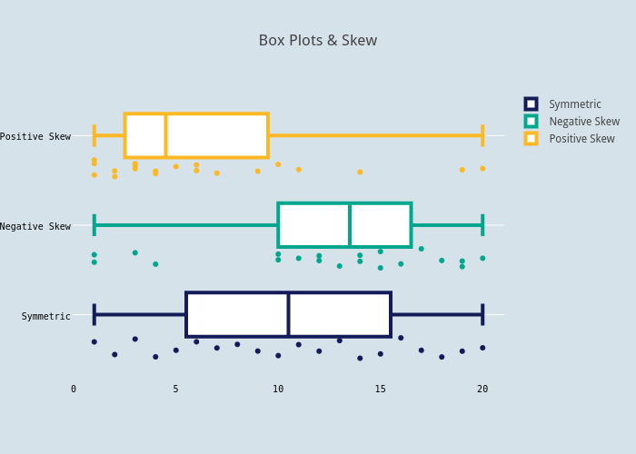
Box plots
Box plots can help you see skewness, outliers, etc.

Slide 11
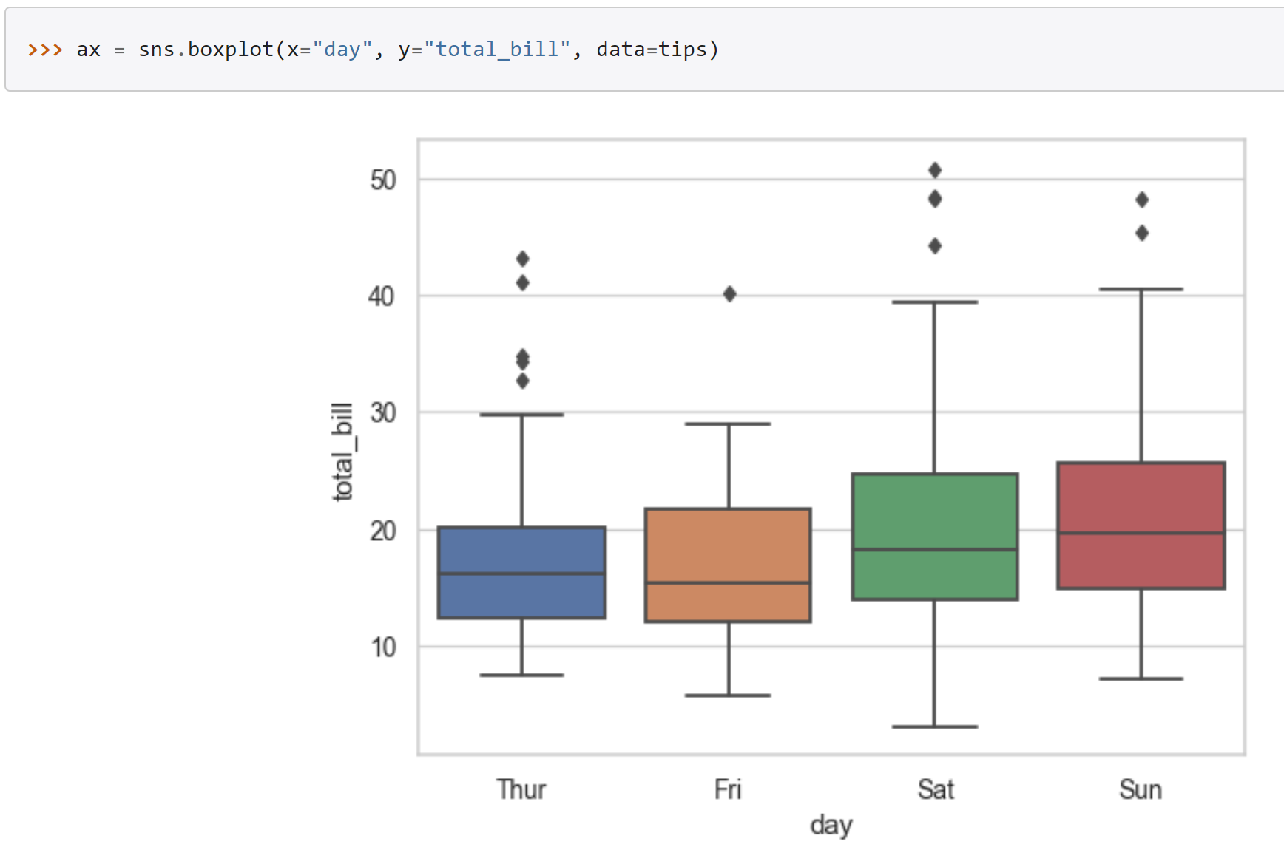
Box plots
Box plot example

Slide 12
Measures of variability
Measure of dispersion of data values
Clustered or spread out?
We’ve seen one already!
IQR
What’s a deviation? A residual?
Difference between an observed value and an estimate value of a quantity of interest, e.g. mean

Slide 13
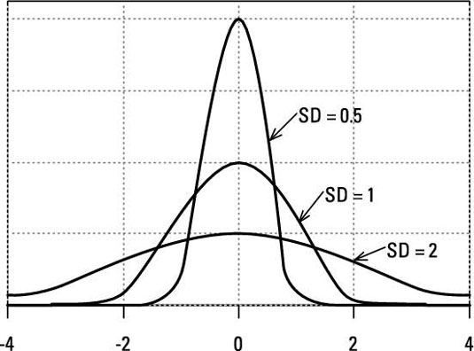
Measures of variability
Variance, standard deviation
These are ways to measure the “spread” of your data
Data with the same mean can have different variances

Slide 14
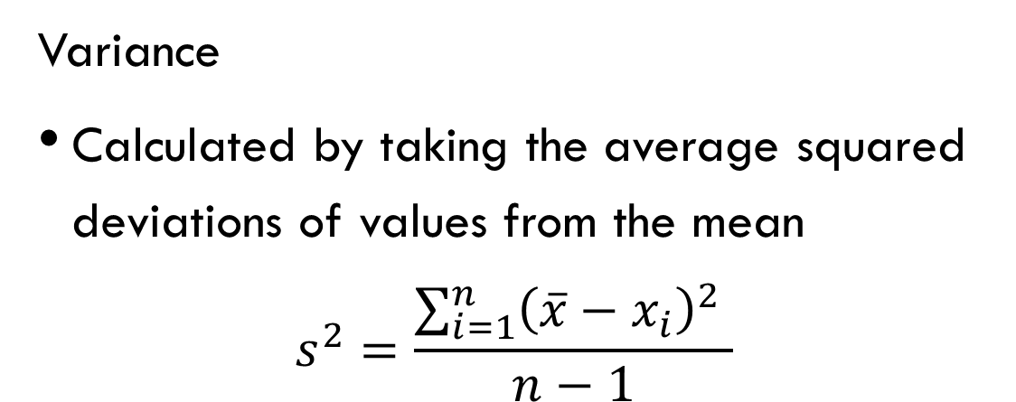
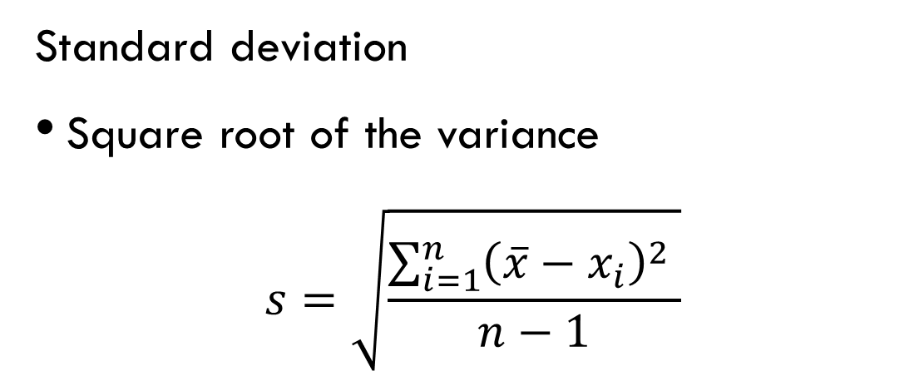
Variance and standard deviation
Variance
Calculated by taking the average squared deviations of values from the mean
$$s^{2}=\frac{\sum_{i=1}^{n}{{\left(\overline{x}−x_{i}\right)}^{2} }}{n−1}$$
Standard deviation
Square root of the variance
$$s=\sqrt{\frac{\sum_{i=1}^{n}{{\left(\overline{x}−x_{i}\right)}^{2} }}{n−1}}$$

Slide 15
Variance and standard deviation
Variance vs. Standard Deviation
Both are measurements of the spread of the data
Standard deviation will be in the same units as the underlying data, while variance will be squared
Both will come up in statistical analysis
A note on N vs N-1
For the population, divide by N. For samples of a population, divide by N-1
If you’re interested in why, go here
If you’re not interested in why, just remember this is why different packages’ stdev functions will give different results

Slide 16
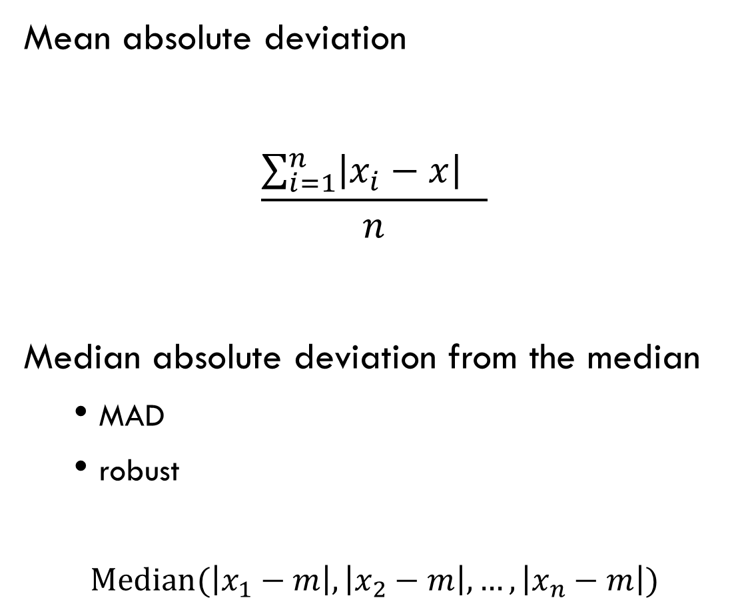
Other measures of variability
Mean absolute deviation
$$\frac{\sum_{i=1}^{n}{\left|x_{i}−x\right| } }{n}$$
Median absolute deviation from the median
MAD
robust
$$\text{Median}(\left|x_{1}−m\right|,\left|x_{2}−m\right|, …,\left|x_{n}−m\right|)$$

Slide 17
Quick note on moments
Ways to Describe the Shape of Data Distribution
First Moment (Location)
Mean
Second Moment (Variability)
Variance
Third Moment
Skewness
Fourth Moment
Kurtosis
Propensity of the data to have extreme values (how do the tails look?)
Generally discovered through visualization

Slide 18
Anscombe’s Quartet
See anscombe.ipynb

Slide 19
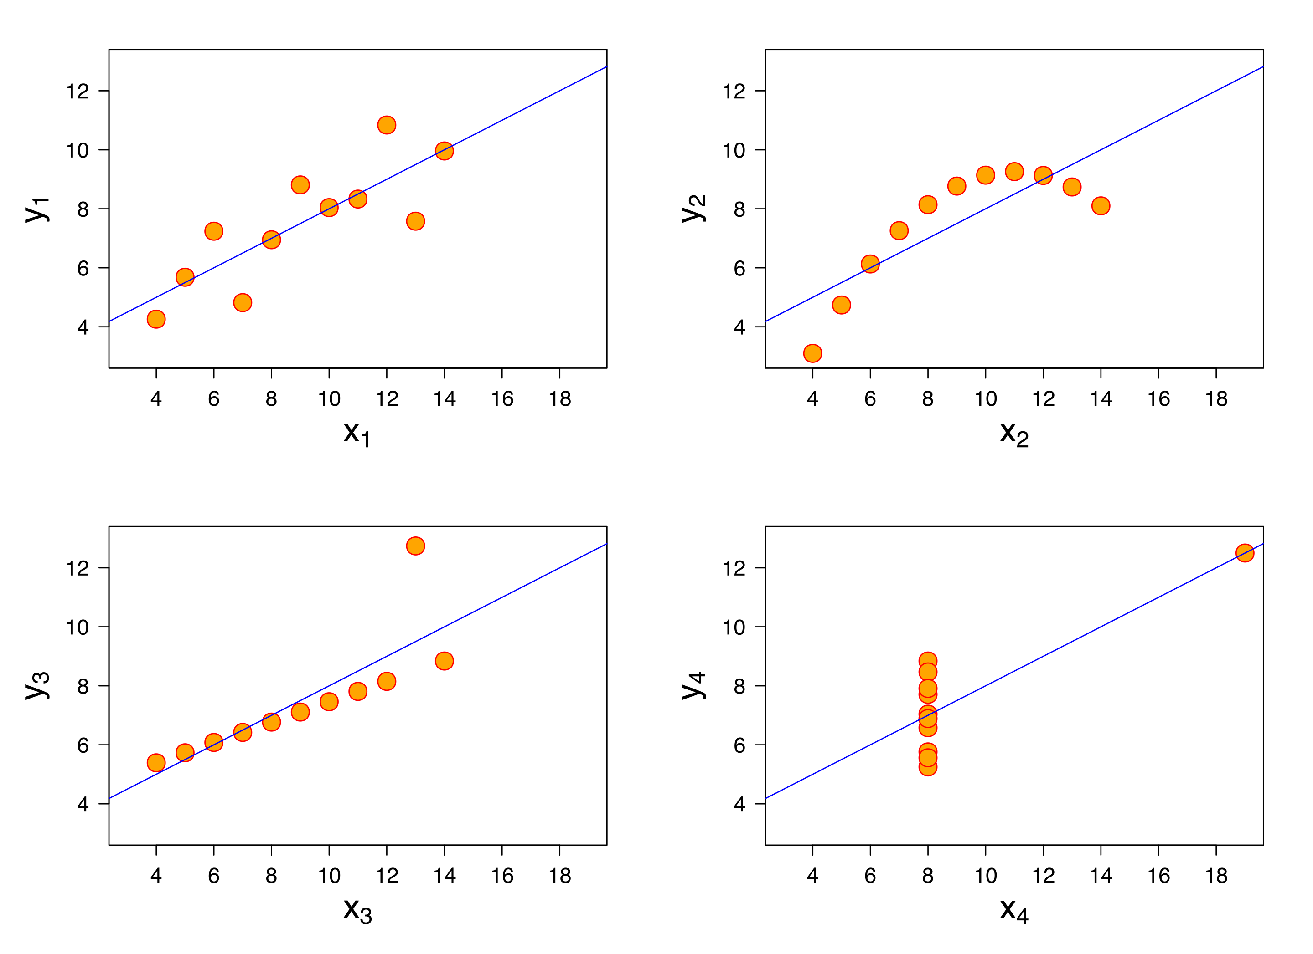
Anscombe’s Quartet: The Reveal

Slide 20
Break?

Slide 21
Distributions
We know how to look at things like mean and spread, and we can get an intuition for how this represents the distribution of data
Distributions
All the values of your data and how often they occur
Useful to get a sense for things like:
Any big values skewing my data? Any bimodal type effects? Etc?
Is it normally distributed? (CAN BE VERY IMPORTANT FOR ML)

Slide 22
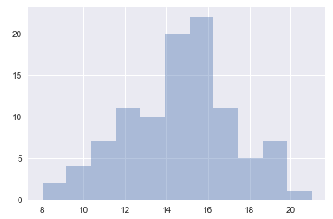
Distributions
So how can we look at distributions?
Histograms
Plot the number of times that values appear in the data
100 trials: flip coin 30 times, record number of heads

Slide 23
Distributions
Ways to look at the distribution of data
Histograms, PMFs, PDFs
PMF – Probability Mass Function
Like a histogram, except normalized by probability
Take the whole dataset and compute the probability of seeing some value
All values in a PMF should sum to 1
PDF – Probability Density Function
Continuous function fit to your PMF
Kernel Density Estimation is a common way

Slide 24
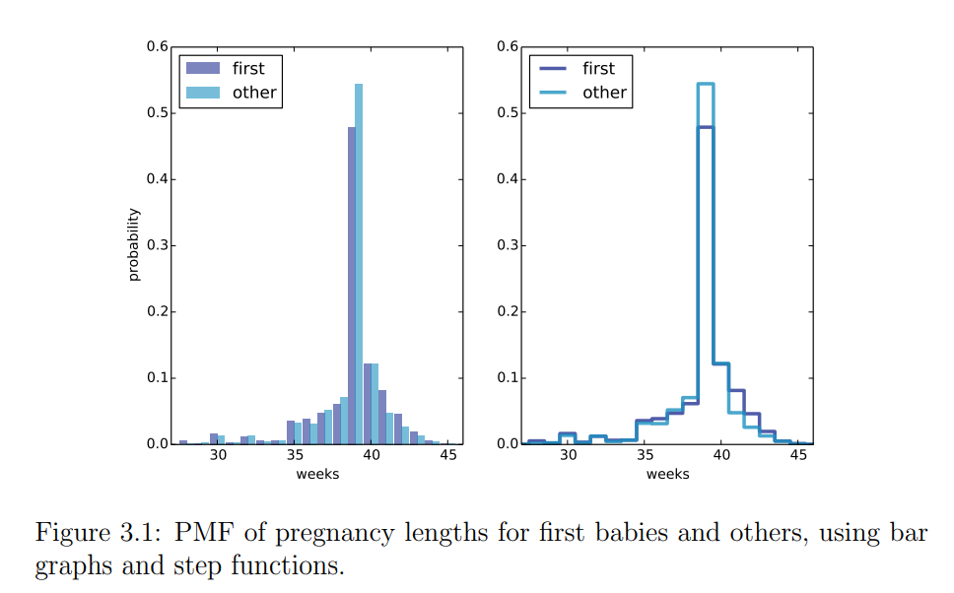
Distributions
Ways to look at the distribution of data
Histogram of counts vs PMF
PMF can be useful if you want to compare histograms from datasets of different sizes, e.g.:

Slide 25
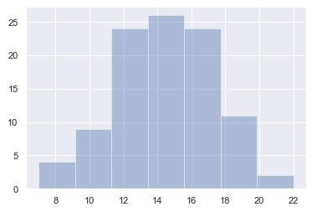
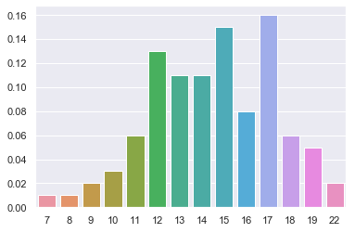
Distributions
Ways to look at the distribution of data
Histogram of counts vs PMF
100 trials of 30 coin flips example:

Slide 26
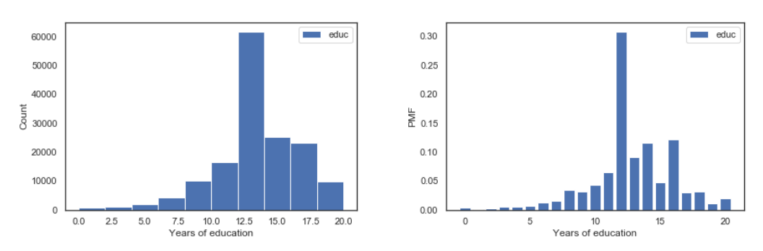
Distributions
Ways to look at the distribution of data
Histogram of counts vs PMF
Education level of survey population
Source: https://s3.amazonaws.com/assets.datacamp.com/production/course_15300/slides/chapter2.pdf

Slide 27
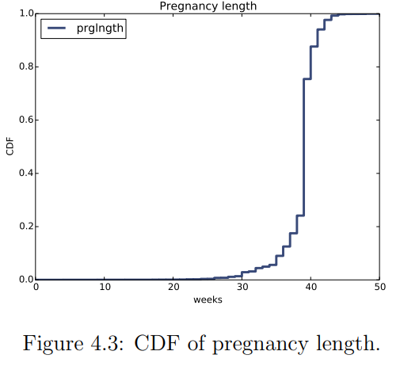
Distributions
Ways to look at the distribution of data
CDFs – map all data to its percentile
Termed ECDF in your reading

Slide 28
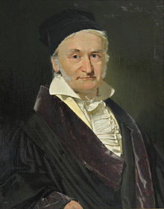
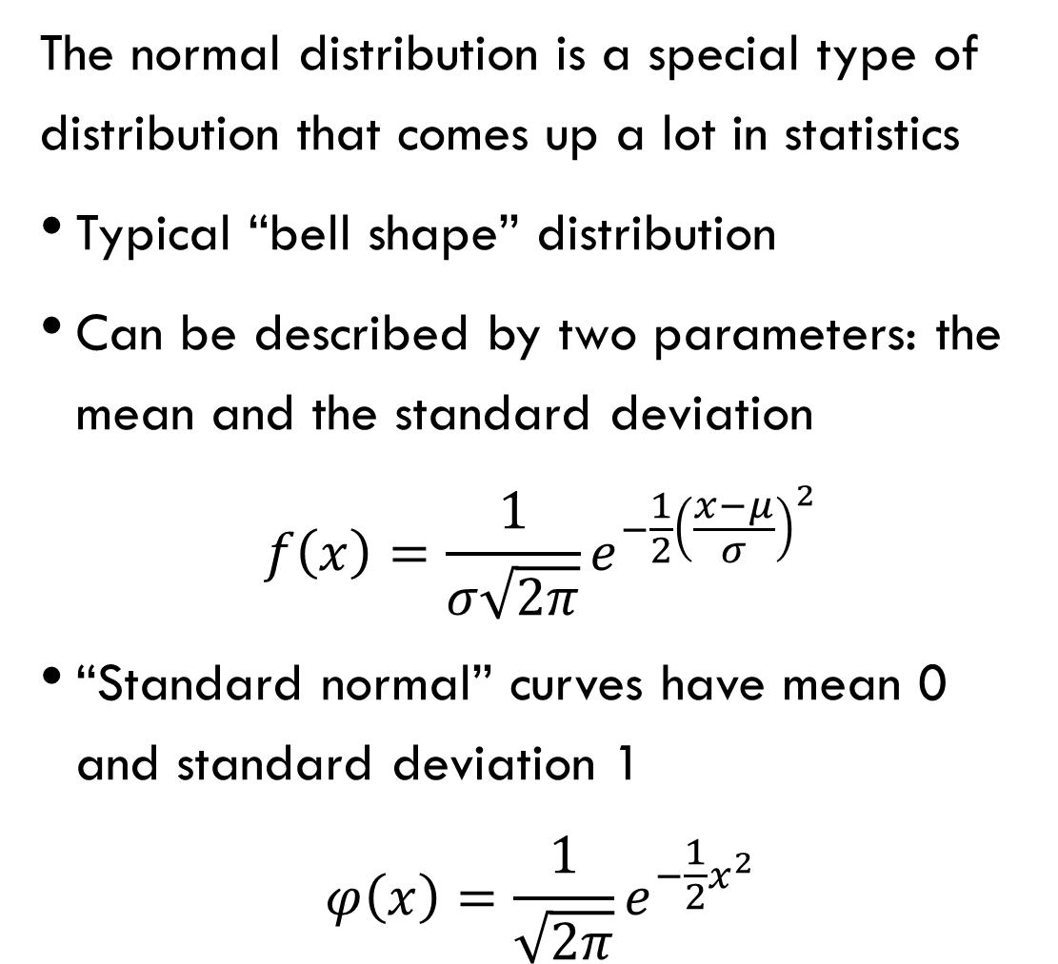
The Normal Distribution!
The normal distribution is a special type of distribution that comes up a lot in statistics
Typical “bell shape” distribution
Can be described by two parameters: the mean and the standard deviation
$$f\left(x\right)=\frac{1}{σ\sqrt{2π}}e^{−\frac{1}{2}{\left(\frac{x−μ}{σ}\right)}^{2}}$$
“Standard normal” curves have mean 0 and standard deviation 1
$$φ\left(x\right)=\frac{1}{\sqrt{2π}}e^{−\frac{1}{2}x^{2}}$$

Slide 29
The Normal Distribution!
Why do we like the normal distribution?
Describes many natural phenomena
Blood pressure, height, hand length, etc
Has some magical properties
Central Limit Theorem
Some mathematical assumptions that power ML models don’t work unless you assume normally distributed data – we’ll cover those when we get there
If we know the mean and stdev, we know how much data falls where

Slide 30
The normal distribution!
In a normal distribution:
50% of the data is above the mean, 50% is below
68/95/99.7 rule:
68% of the data falls within 1 standard deviation of the mean
95% of the data falls within 2 standard deviations of the mean
99.7% of the data falls within 3 standard deviations of the mean

Slide 31
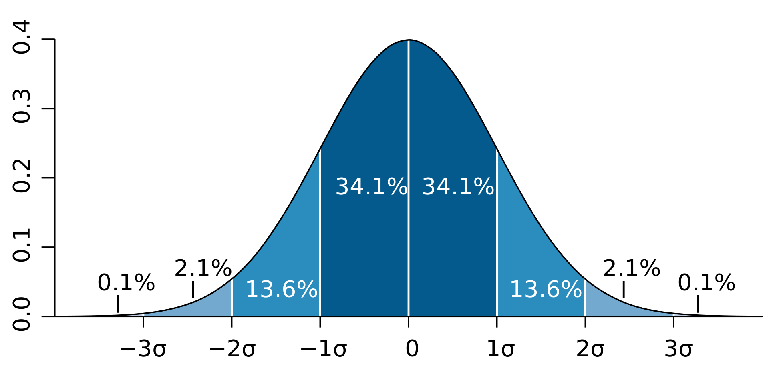

The normal distribution!
68/95/99.7 rule:
Given mean $μ$ and stdev $σ$:
https://www.khanacademy.org/math/statistics-probability/modeling-distributions-of-data/normal-distributions-library/e/empirical_rule

Slide 32
Central limit theorem
First, Not all data is normally distributed!!
That out of the way, the CLT states:
“Given certain conditions, the arithmetic mean of a sufficiently large number of iterates of independent random variables, each with a well-defined (finite) expected value and finite variance, will be approximately normally distributed, regardless of the underlying distribution.”

Slide 33
Central limit theorem
The Central Limit Theorem:
What?
The CLT states: if you take sufficiently large samples from a distribution, the means of those samples will be approximately normally distributed, even if the distribution you’re sampling from is not normal
(“Sufficiently large?” Depends, ~30, rule of thumb)

Slide 34
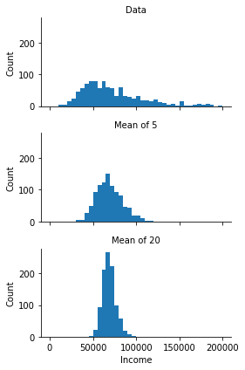
Central limit theorem
Histogram of 1000 draws
Source

Slide 35
Central limit theorem
Some other visualizations to check out for more info:
http://mfviz.com/central-limit/
https://seeing-theory.brown.edu/probability-distributions/index.html

Slide 36
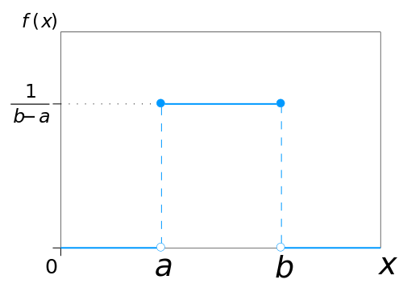
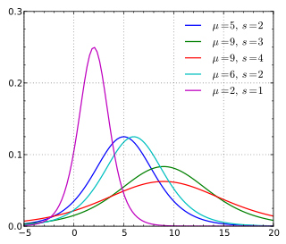
Other probability density distributions
Infinitely many possible PDFs
Uniform
Logistic
X values express relative likelihood. Only an area under a range of the PDF expresses probability.

Slide 37
Statistics and experiments
“There are three kinds of lies: lies, damned lies, and statistics”
- Unknown
“While it is easy to lie with statistics, it is even easier to lie without them.”
- Fred Mosteller
“He uses statistics as a drunken man uses lamp-posts...for support rather than illumination.”
- Also Unknown (maybe Andrew Lang)

Slide 38
Statistics and experiments
Let’s talk today about questions you can answer with statistics
Experimental sampling – what can I figure out about a population if I can’t measure the whole group?
Hypothesis testing – Are these two groups different? Did my new website feature increase sales? Is one drug treatment better than another? Etc.

Slide 39
Experimental metrics
Very often you can’t measure a whole population, you have to take a sample and make some assumptions about the underlying distribution
E.g. voter polls, coronavirus?
Sampling distributions
Sample mean vs. population mean
Standard deviation vs. standard error

Slide 40
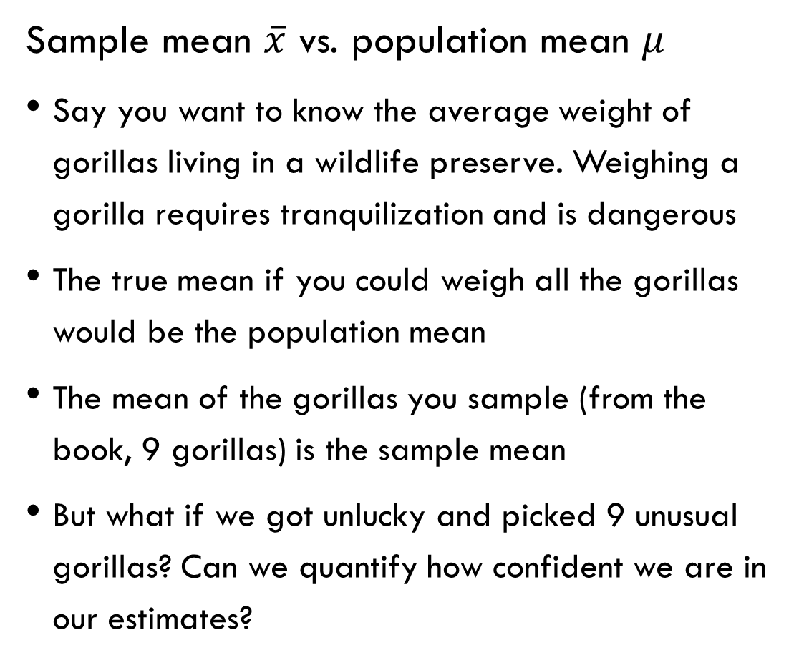
Experimental metrics
Sample mean $\overline{x}$ vs. population mean $μ$
Say you want to know the average weight of gorillas living in a wildlife preserve. Weighing a gorilla requires tranquilization and is dangerous
The true mean if you could weigh all the gorillas would be the population mean
The mean of the gorillas you sample (from the book, 9 gorillas) is the sample mean
But what if we got unlucky and picked 9 unusual gorillas? Can we quantify how confident we are in our estimates?
Source: http://greenteapress.com/thinkstats2/thinkstats2.pdf

Slide 41
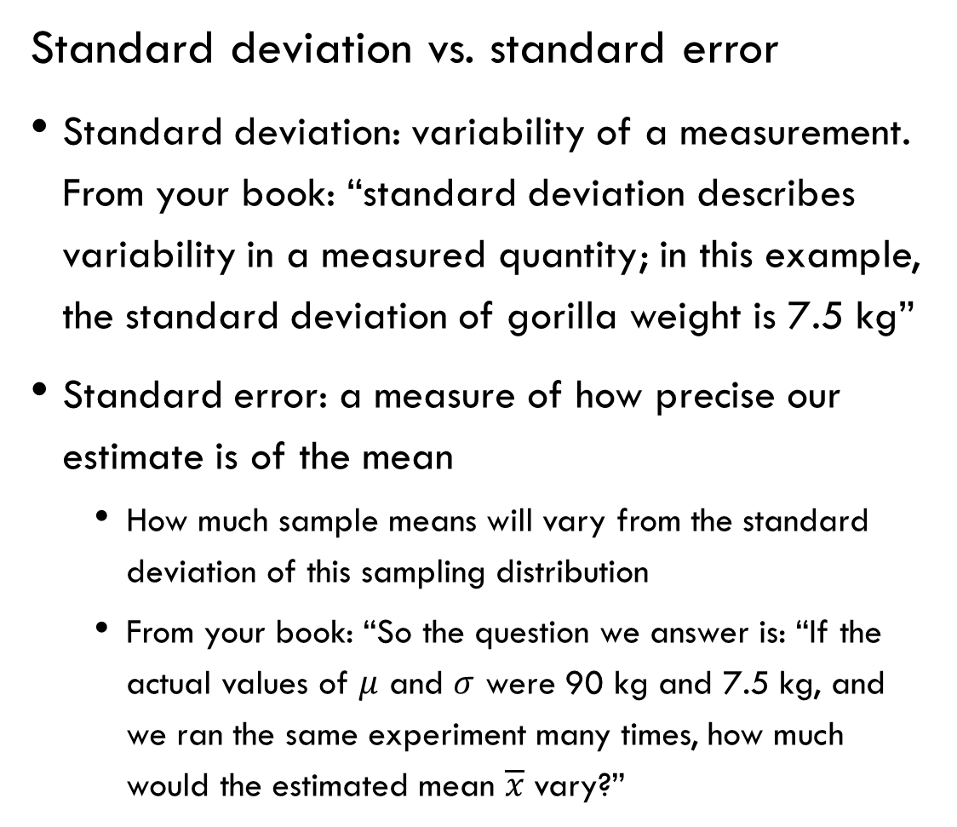
Experimental metrics
Standard deviation vs. standard error
Standard deviation: variability of a measurement. From your book: “standard deviation describes variability in a measured quantity; in this example, the standard deviation of gorilla weight is 7.5 kg”
Standard error: a measure of how precise our estimate is of the mean
How much sample means will vary from the standard deviation of this sampling distribution
From your book: “So the question we answer is: “If the actual values of $μ$ and $σ$ were 90 kg and 7.5 kg, and we ran the same experiment many times, how much would the estimated mean $\overline{x}$ vary?”

Slide 42
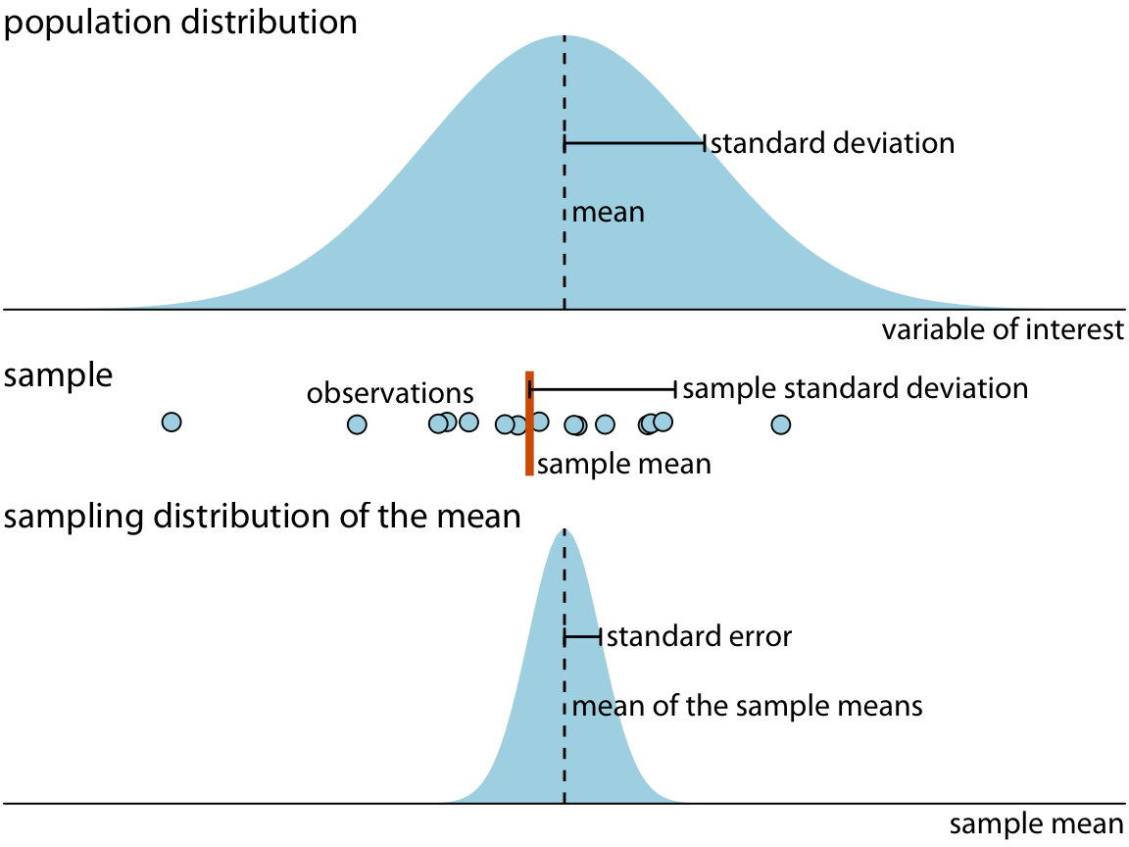
Experimental metrics
https://serialmentor.com/dataviz/visualizing-uncertainty.html

Slide 43
Experimental metrics
Let’s go back to the question: “But what if we got unlucky and picked 9 unusual gorillas? Can we quantify how confident we are in our estimates?”
One way is sample error
Another way is confidence intervals
Confidence intervals work like this: for a 95% confidence interval, if you ran the same experiment 100 times, the true sample mean would fall within that range 95 times
Calculated as a function of mean, standard error, sample size, and z-score
https://seeing-theory.brown.edu/frequentist-inference/index.html

Slide 44
Hypothesis testing
Hypothesis testing in statistics
We’ve talked about distributions. It should feel intuitive that if you’re sampling a population, there’s a chance you could randomly sample a part of the data that could give you an inaccurate understanding of the underlying distribution
E.g., coin flips. Is it possible to flip 100 heads in a row?

Slide 45
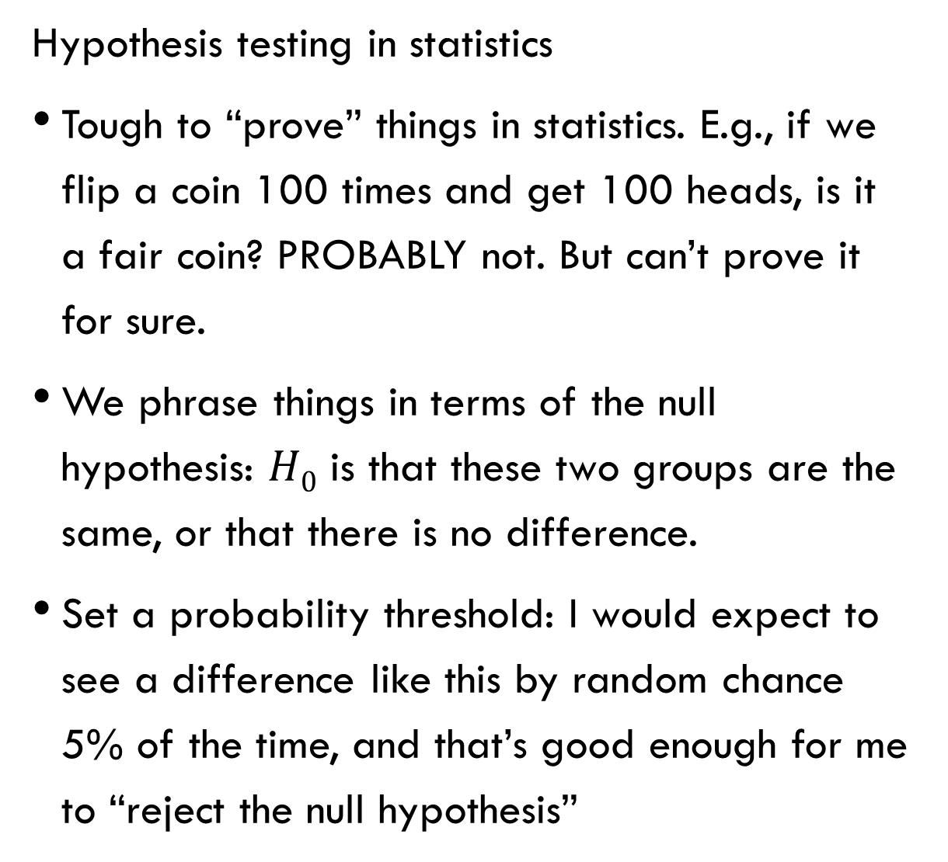
Hypothesis testing
Hypothesis testing in statistics
Tough to “prove” things in statistics. E.g., if we flip a coin 100 times and get 100 heads, is it a fair coin? PROBABLY not. But can’t prove it for sure.
We phrase things in terms of the null hypothesis: $H0$ is that these two groups are the same, or that there is no difference.
Set a probability threshold: I would expect to see a difference like this by random chance 5% of the time, and that’s good enough for me to “reject the null hypothesis”

Slide 46
Hypothesis testing
P-value
“In general, the P-value is the probability that sample results are as extreme as or more extreme than the result observed in the data if the null hypothesis is true.”
P-values are somewhat arbitrary and should be defined in advance of an experiment
Remember – if you set your P-value threshold at 0.05, 1/20 times you run an experiment you’d expect a false positive
https://xkcd.com/1478/
https://xkcd.com/882/

Slide 47

Hypothesis testing
Example: In 2008 Obama won 40% of the white male vote. It is 2012, so we sample 200 white male voters to measure their support for Obama. We find 35% support. Has support decreased?
$H0$: Support has not decreased
$Ha$: Support has decreased
https://courses.lumenlearning.com/atd-herkimer-statisticssocsci/chapter/introduction-to-hypothesis-testing-4-of-5/

Slide 48
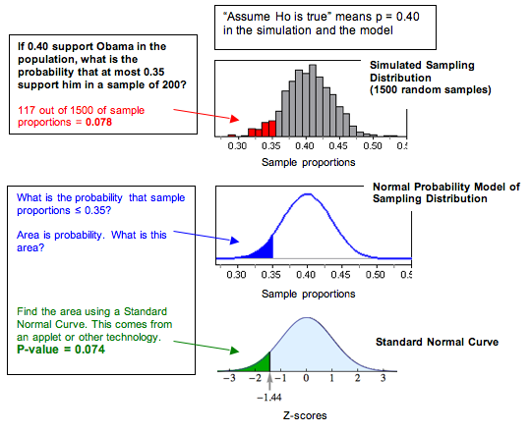
Hypothesis testing
https://courses.lumenlearning.com/atd-herkimer-statisticssocsci/chapter/introduction-to-hypothesis-testing-4-of-5/

Slide 49
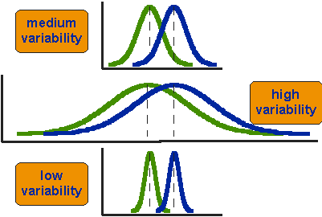
Hypothesis testing
Should feel intuitive that you need to know both the mean and the variance to compare populations
https://socialresearchmethods.net/kb/statistical-student-t-test/

Slide 50
Hypothesis Testing: T-Test
Common significance test to detect a difference of means between two groups
Uses standard t-statistic
Instead of more theory, freely use scipy.stats.ttest_ind to build evidence
ttest.ipynb

Slide 51
Break?

Slide 52
Bootstrapping
“bootstrap” (noun)
A procedure to estimate the distribution of a sample statistic by resampling
Taking samples with replacement from the sample itself and recalculating the statistic or model for each sample
This builds an estimate of the sample statistic’s distribution
Alternative to hypothesis testing
Instead of having me talk, how about a movie?
bootstrapping video
bootstrapping introduction

Slide 53
Bootstrapping
Any questions from the movie?

Slide 54
My heartfelt thanks to the mentors for their help this past week!!!

